Slide 1
Housing Price Prediction
Gloria Shen, Junfeng Li, Yuehai Shen

Slide 2
Topic & Objectives
We are predicting the housing sales price in California. In order to improve the accuracy of our prediction, we will only focus on the house price for sale, and only includes the top cities with top 150 populations.
Combining different data including housing price data, cities demographics data, and neighborhood reviews data.

Slide 3
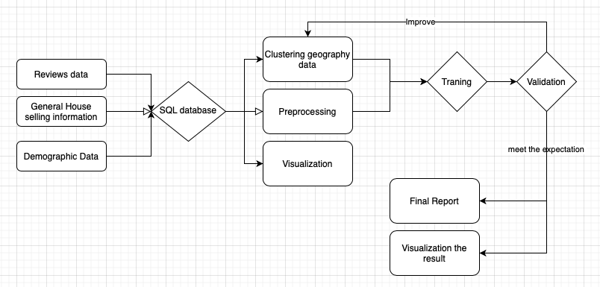
General Approach

Slide 4
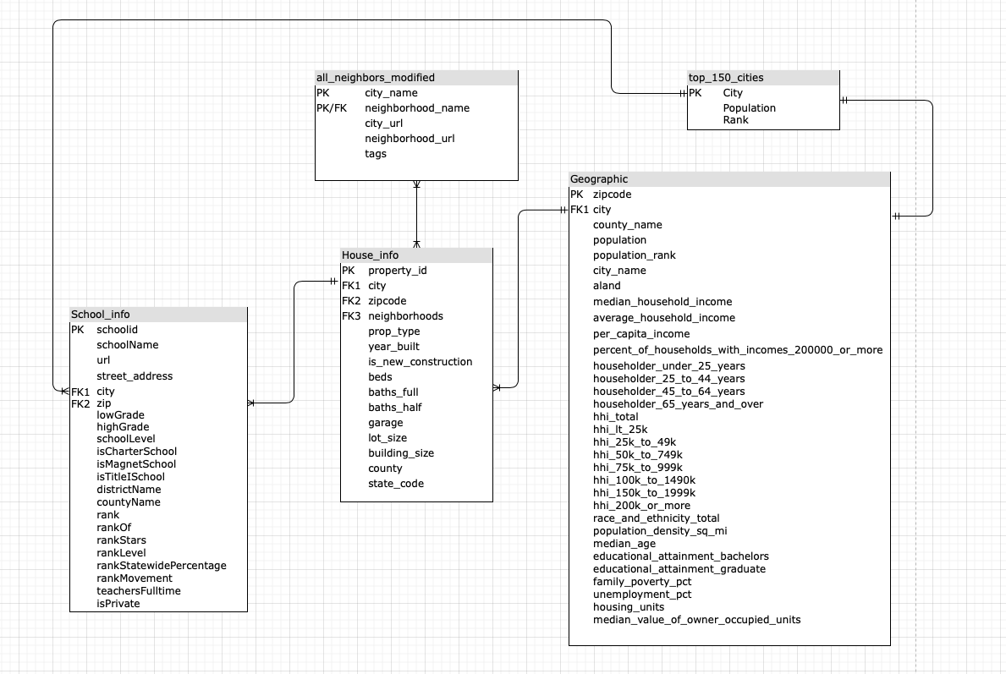
Datasets
- ER Diagram

Slide 5
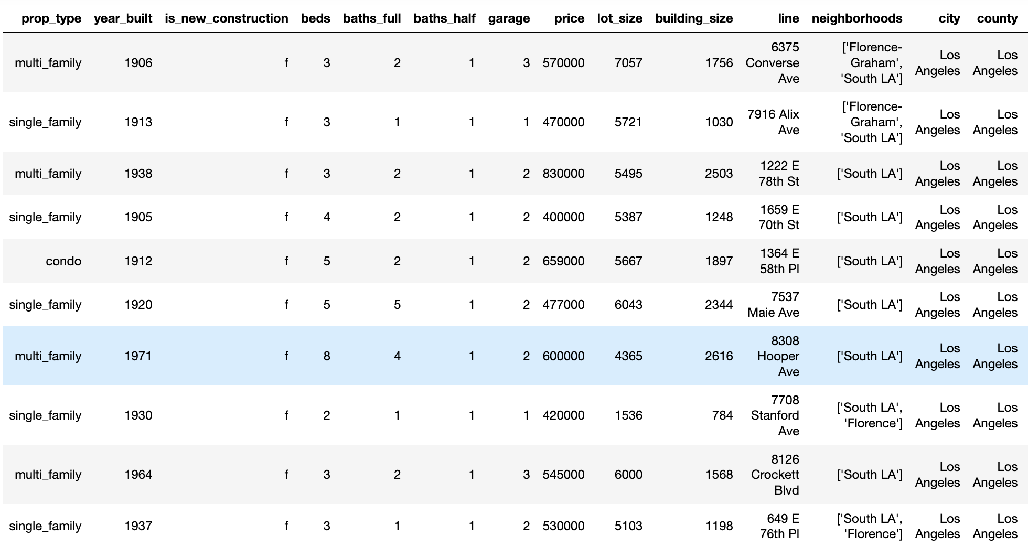
Datasets - General Housing Information
Data from Realtor API via rapidapi.com

Slide 6
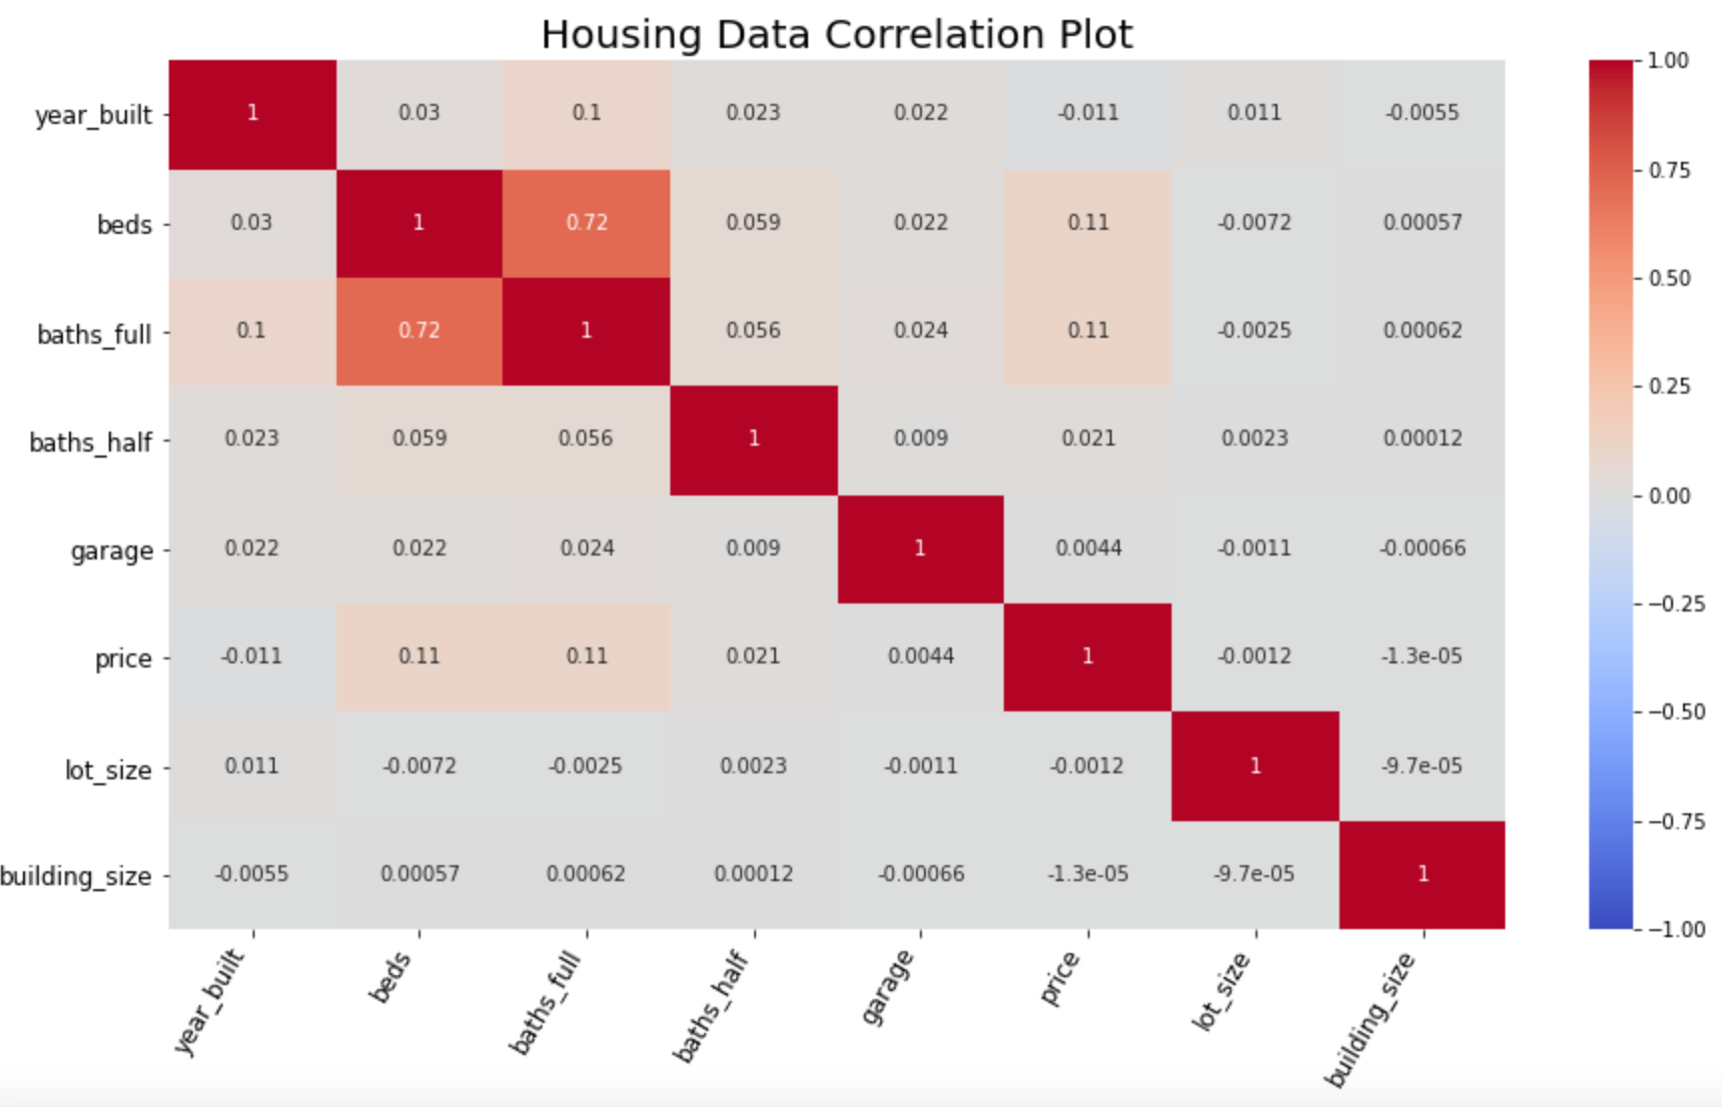
Housing Data Correlation Plot

Slide 7
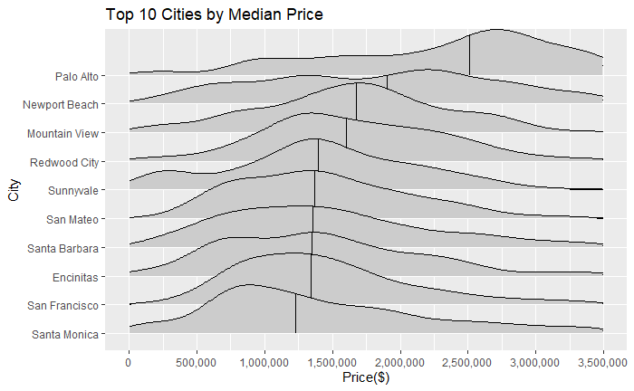
Top 10 Cities Sorted By Median Price

Slide 8
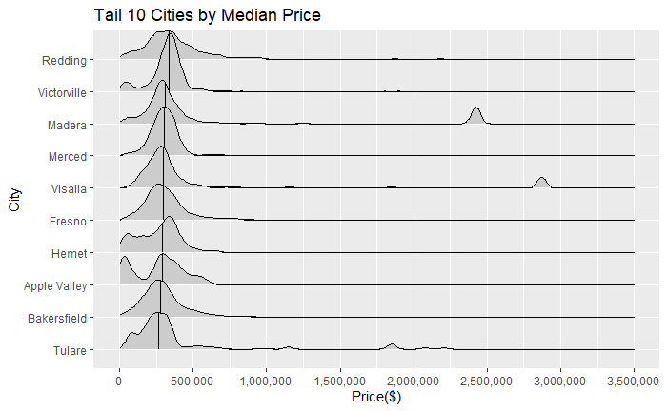
Tail 10 Cities Sorted By Median Price

Slide 9
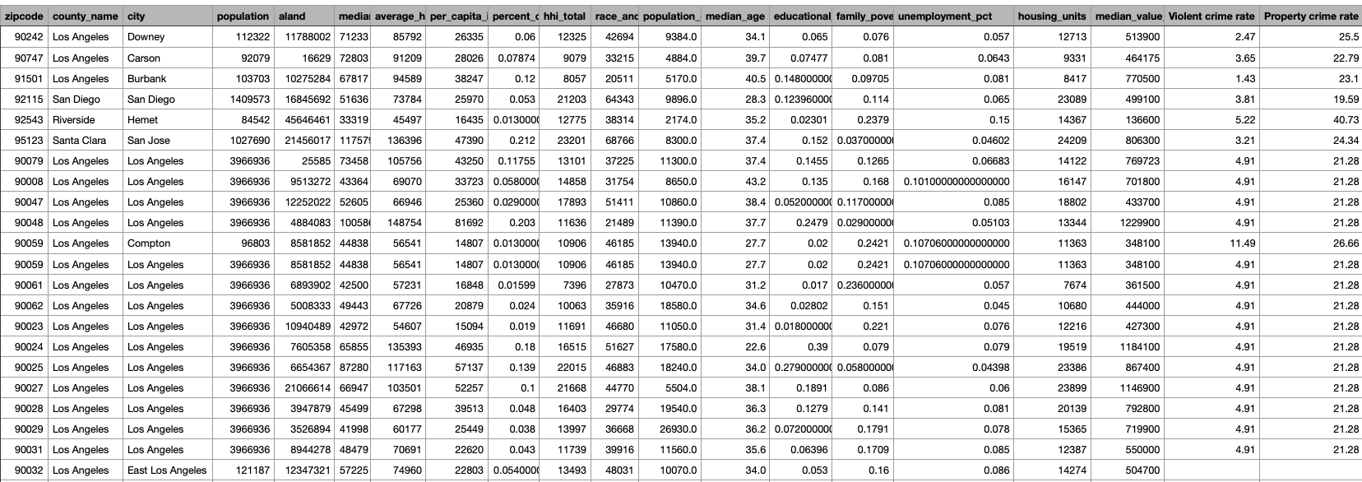
Datasets - demographic
- Median Households, Mean income, Per capital income in the past 12 months, percent of households with income more than 200,000, Median household Income by Age of Householder, age&sex and educationl level, unemployement and crime rate, by zipcode.
Data from https://www.incomebyzipcode.com

Slide 10
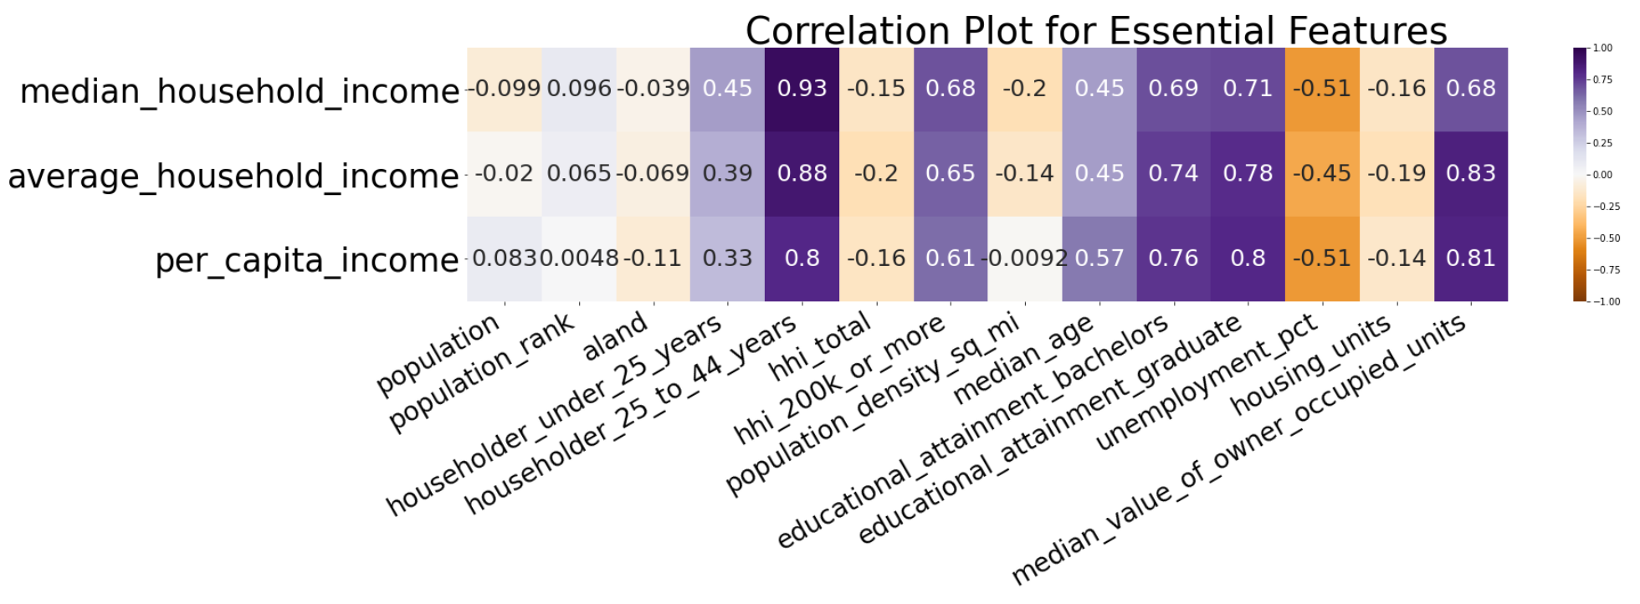

Slide 11
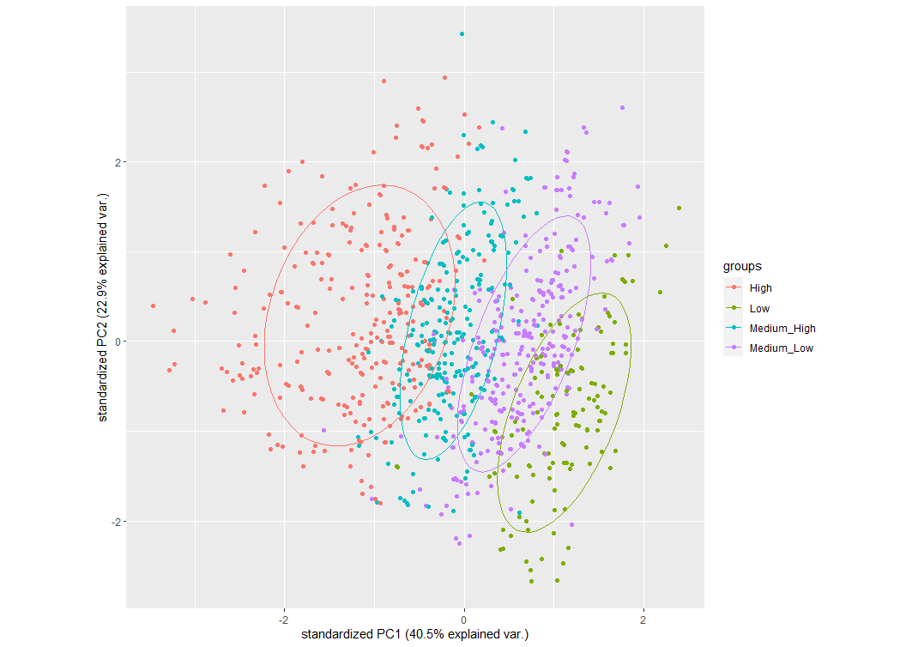
PCA plot(1st Component and 2nd Component)

Slide 12
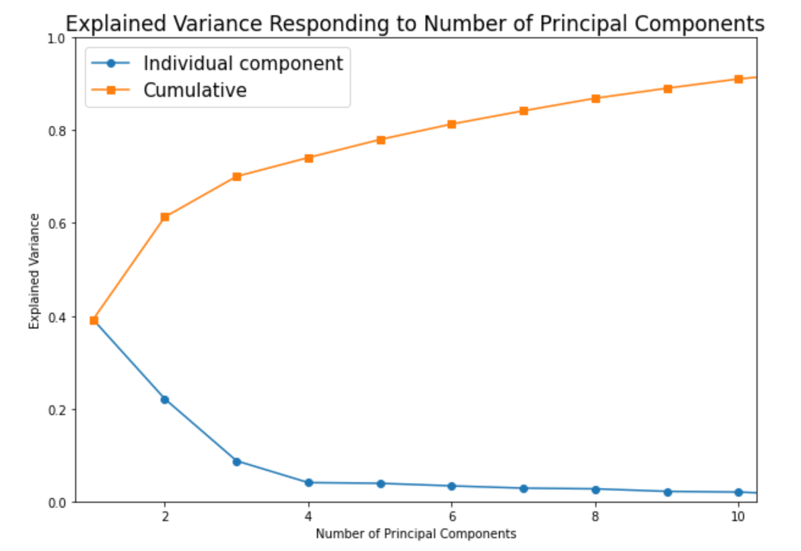
Explained Variance

Slide 13
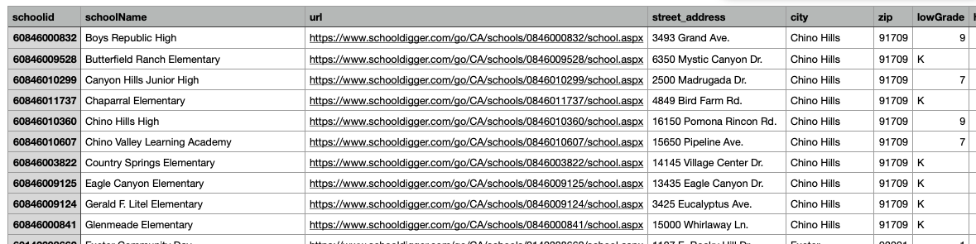
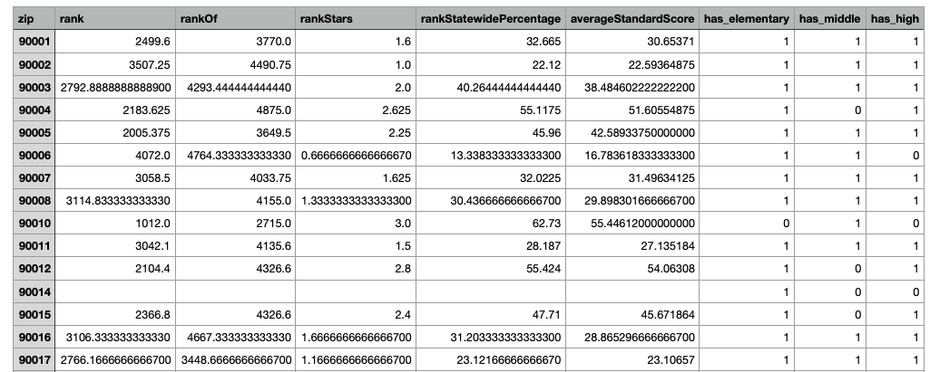
School Data
Data from SchoolDigger API

Slide 14
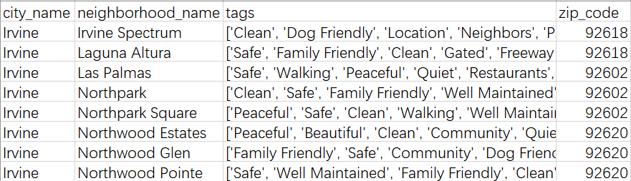
Neighborhood Data
Data from NextDoor.com

Slide 15
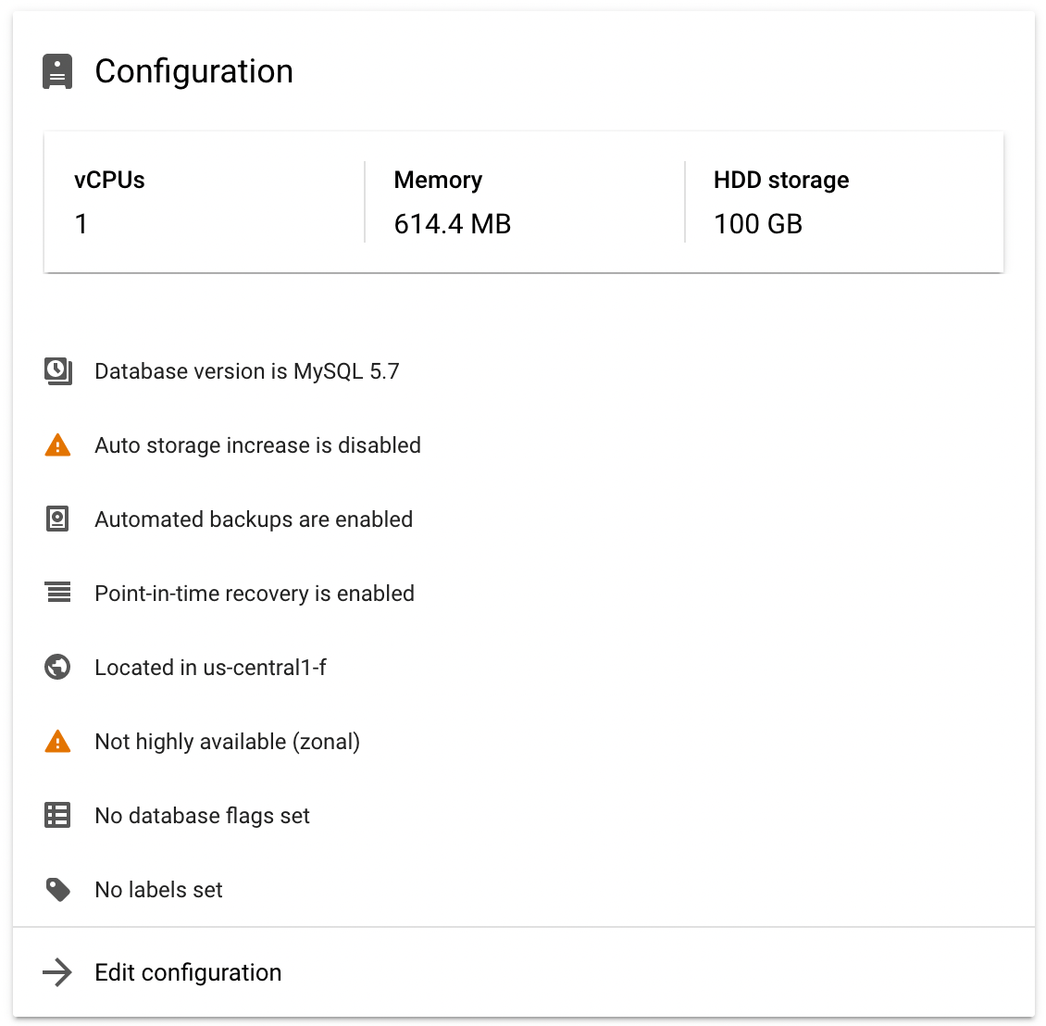
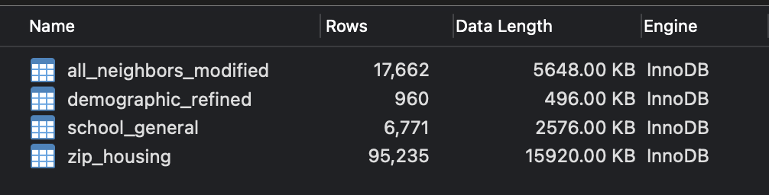
GCP Data Management

Slide 16
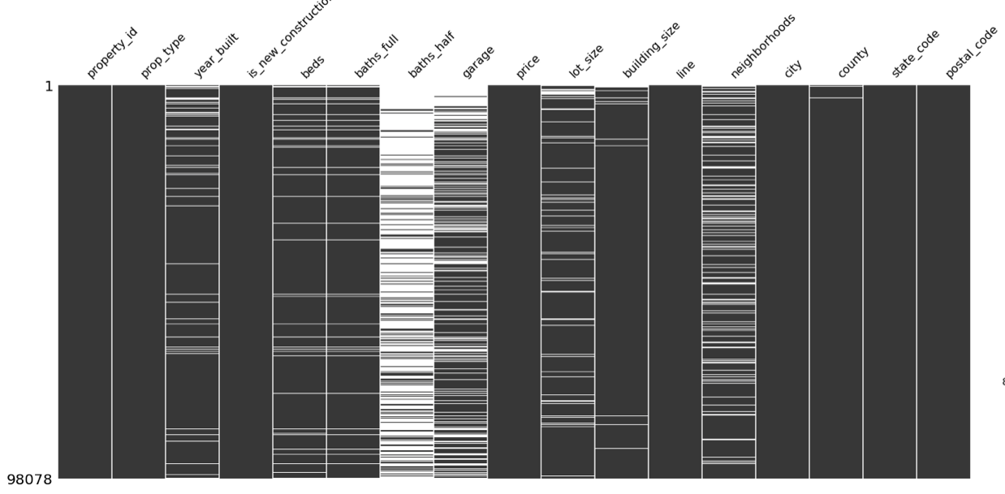
Preprocessing - Missing value

Slide 17
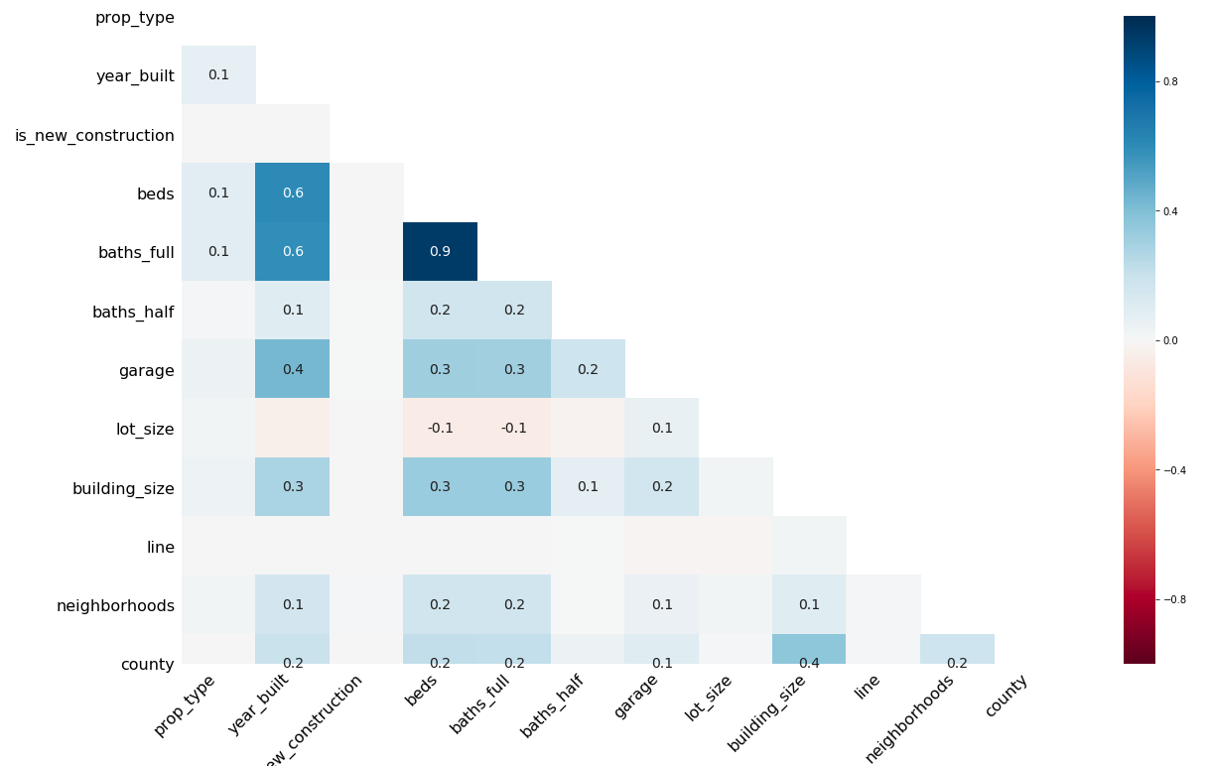
Preprocessing - Missing value

Slide 18
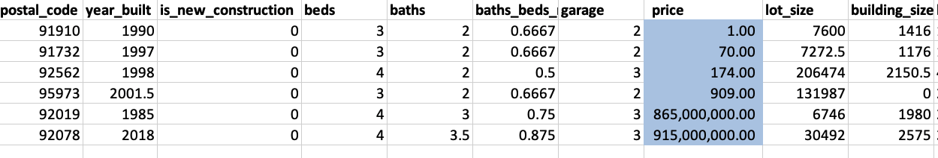
Data preprocessing - Outliers
By exploring the original data set, we find that several outlier with extremely high or low sale price comparing. In order to drop outlier in multiple-dimensional , we first tried DBSCAN* to tag the outliers and drop it, but we after we tried IQR** method, we think IQR can do the job better.
DBSCAN*: Density-based spatial clustering of applications with noise
IQR**: Interquartile Range

Slide 19
Stat/ML Methods - Method 1: Linear Regression(Baseline)
A popular and commonly used method in different areas to solve regression problems
Adjusting coefficients for each predictor to get a linear model that having the least sum of squared error
Our data doesn’t have a huge amount of predictors
Linear regression is very efficient and may give out good result potentially

Slide 20
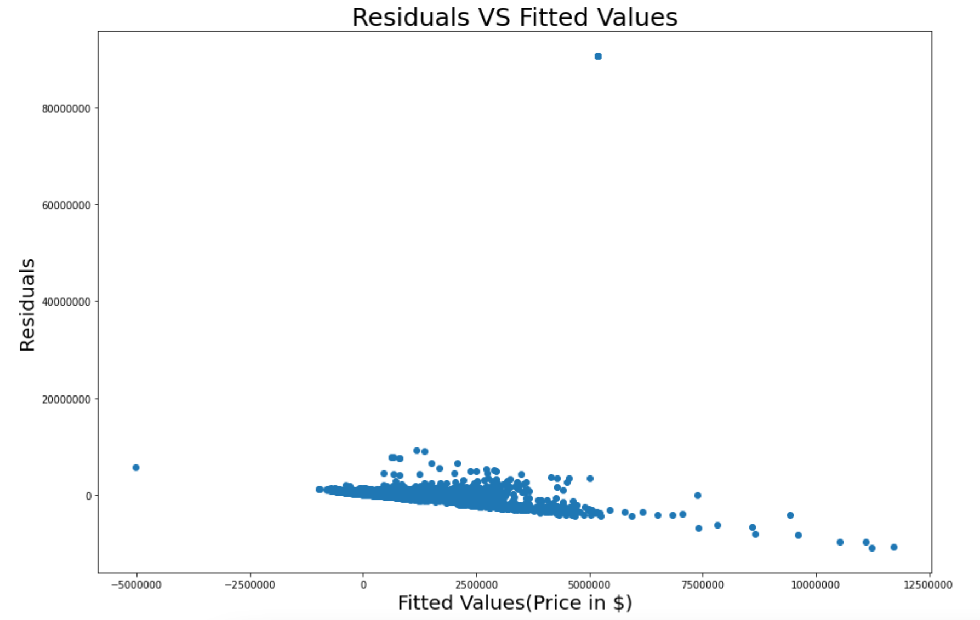
Stat/ML Methods - Method 1: Linear Regression(Baseline)
Mean R-Square = 0.078;
Train RMSE =2566798;
Test RMSE = 2823458;
No significant pattern;
Some huge residuals;

Slide 21
Stat/ML Methods - Method 2: KNN
Popular algorithm in Machine Learning
Finding nearest k(adjustable) samples around predicting point and calculating the samples’ mean as the predictive value of this point
More adjustable parameters than linear regression to find better result
Also efficient especially when k is relatively small

Slide 22
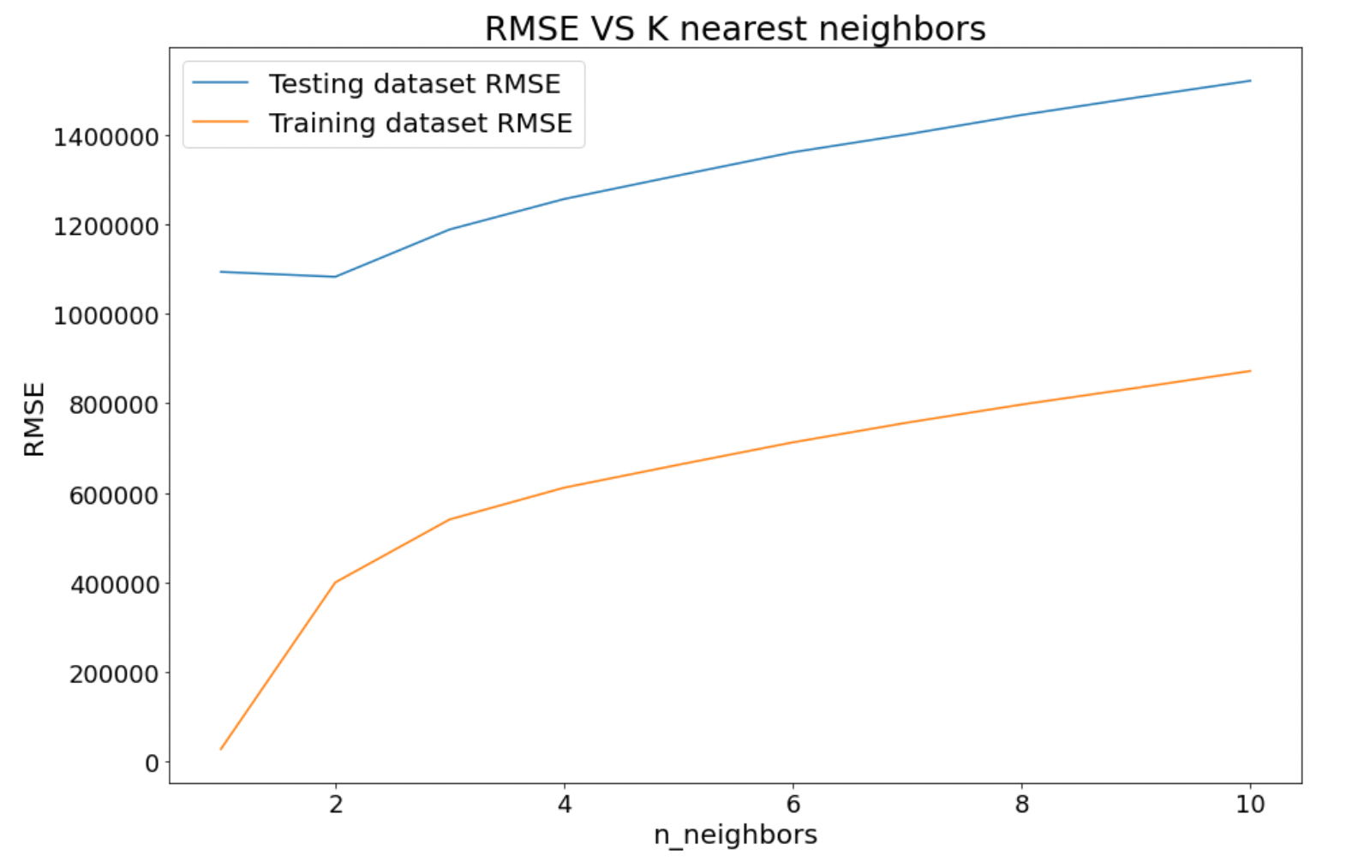
Stat/ML Methods - Method 2: KNN
Testing RMSE(k=2): 1082530
Training RMSE(k=2): 400271

Slide 23
Stat/ML Methods - Method 2: KNN
Mean score after cross validation(split = 5) with k = 2: 0.96
Explain 96% of the variance in the data.
High score, and high RMSE

Slide 24
Stat/ML Methods - Method 3: Random Forest
More parameters(n-estimators, max depth, max leaf nodes) to adjust
Contains multiple decision trees and output result based on vote from each of them
Research states random forest has better performance
Balance between efficiency and accuracy, very likely to be the best performance overall

Slide 25
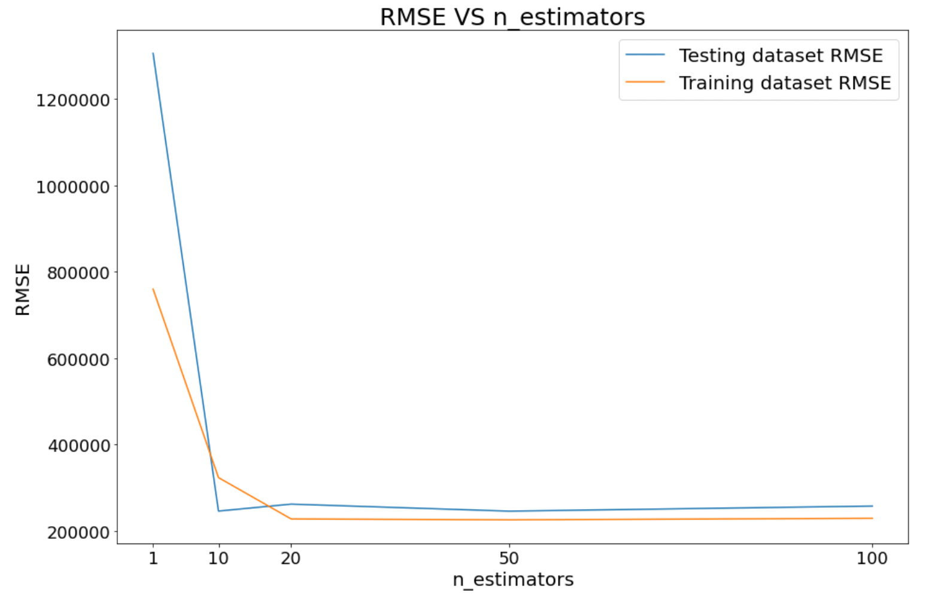
Stat/ML Methods - Method 3: Random Forest
Best n_estimators: 50
Training RMSE = 223569
Testing RMSE = 235076

Slide 26
Stat/ML Methods - Method 3: Random Forest
Mean score after cross validation(split = 5): 0.92
Random forest has the best performance at this stage
No overfit at n = 50
High score, and relatively low RMSE
Will adjust parameters to achieve a better result on random forest
Will also try more complex method such as neural network

Slide 27
Timeline
Week 1: Data collection and wrangling
Week 2: Data wrangling
Week 3: Finish up data wrangling (combine columns and datasets, etc.)
Week 4: Start training and testing simple models on partial data
Week 5-7: Continuing training and testing other models and approaching to apply them to full-scale data
Week 7+: Finishing up the training and testing along with starting the final report draft

